Slide 1
Testing the quantity theory of money
Class 1, Wei Zhiyuan

Slide 2
Contents
Quantity Theory of Money Basics
Quantity Theory of Money in the Long Run
Quantity Theory of Money in the Short Run
Something More

Slide 3

Quantity Theory of Money Basics
Quantity theory of money:
$$P×Y=M×V$$
Transform it into a theory of inflation:
$\%∆P+\%∆Y=\%∆M+\%∆V$（ * ）
$$→ π=\%∆P=\%∆M+\%∆V−\%∆Y$$
Assuming V is constant:
$$π=\%∆M−\%∆Y$$
（*）Percentage Change in (x * y) = (Percentage Change in x) + (Percentage Change in y)

Slide 4

Quantity Theory of Money in the Long Run
Sources: Federal Reserve Bank of St. Louis, FRED database: http://research.stlouisfed .org/fred2/.

Slide 5

Quantity Theory of Money in the Long Run
Sources: International Financial Statistics. International Monetary Fund, http://www.imfstatistics.org/imf/.

Slide 6
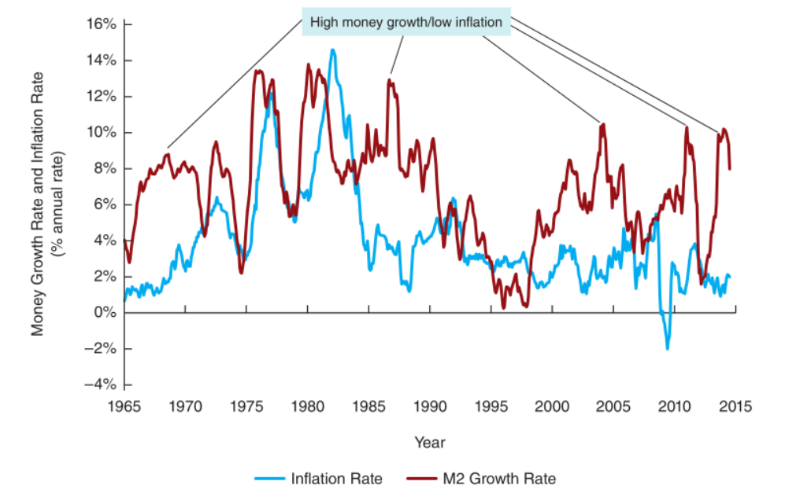

Quantity Theory of Money in the Short Run
r = 0.1130
Sources: Federal Reserve Bank of St. Louis, FRED database: http://research.stlouisfed .org/fred2/.

Slide 7

Quantity Theory of Money in the Short Run
Long run√ short run╳
“Inflation is always and everywhere a monetary phenomenon.”
——Milton Friedman
Why not short run?

Slide 8
Something More
Sources: International Financial Statistics. International Monetary Fund, http://www.imfstatistics.org/imf/.

Slide 9

Something More
Back to $\%∆P+\%∆Y=\%∆M+\%∆V$:
r = 0.89668
Sources: Federal Reserve Bank of St. Louis, FRED database: http://research.stlouisfed .org/fred2/.

Slide 10
Thanks.
Testing the quantity theory of money
Class 1, Wei Zhiyuan

